Slide 1




Notes:
*

Slide 2


UI ENGINEERING STUDIO
UI Engineering Studio. Day 8 Bootcamp: JS Asynchronous

Slide 3


UI ENGINEERING STUDIO
JS Asynchronous
Asynchronous
not happening or done at the same time or speed
-Cambridge
Callback Hell
Promises
Async & Await

Slide 4
UI ENGINEERING STUDIO
UI Boot Camp: JS JS Asynchronous Code
Function declaration
function sumar(a, b) {
var c = a + b;
setTimeout(()=> {c = c*2})
return c;
}
JavaScript is a blocking, single-threaded language
Eventloop
Next tick
Callbacks: just the name of a convention for using JavaScript functions. There isn't a special thing called a 'callback' in the JavaScript language, it's just a convention
-MDN
Function expression
var request = require('request'); request('http://sohamkamani.com', function (error, response, body) { console.log(body); }) console.log('I come after the request');

Slide 5
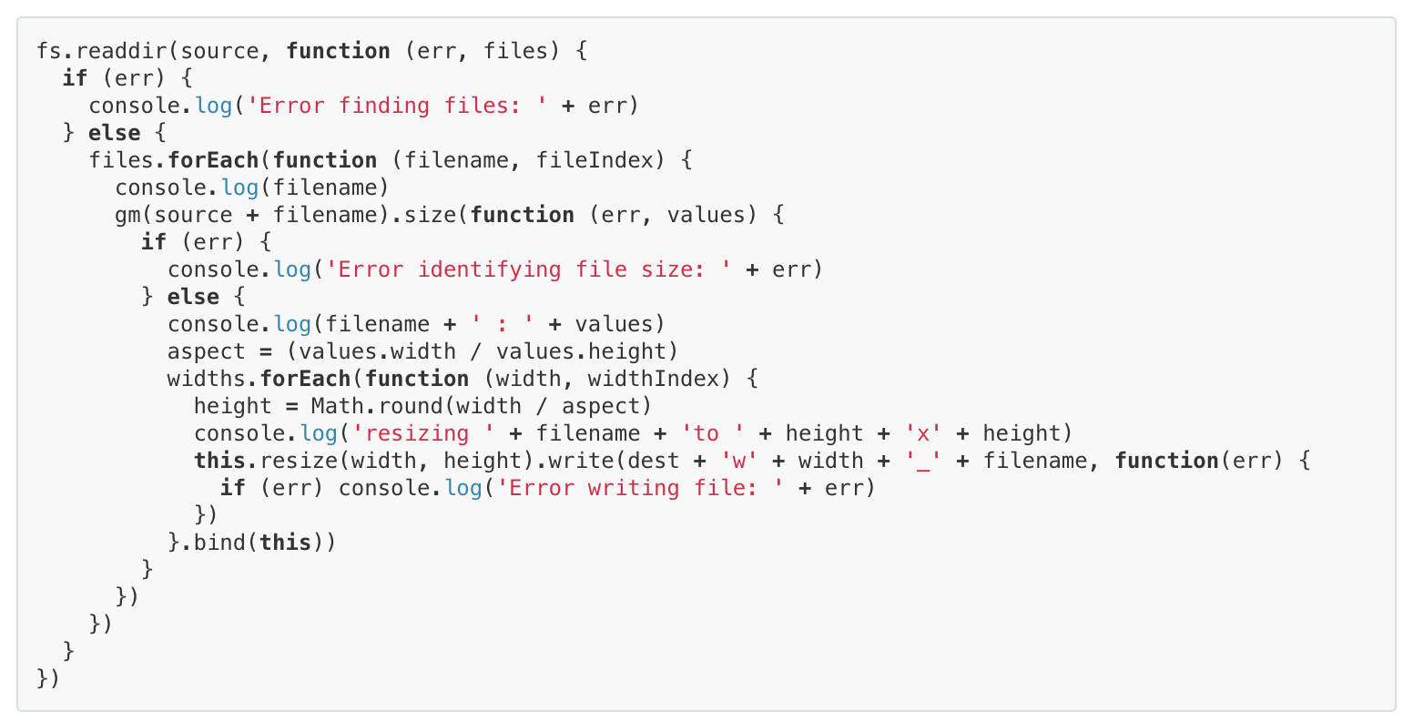
UI ENGINEERING STUDIO
UI Boot Camp: JS
Callback and Callback Hell
Asynchronous JavaScript, or JavaScript that uses callbacks, is hard to get right intuitively. A lot of code ends up looking like this:
source

Slide 6
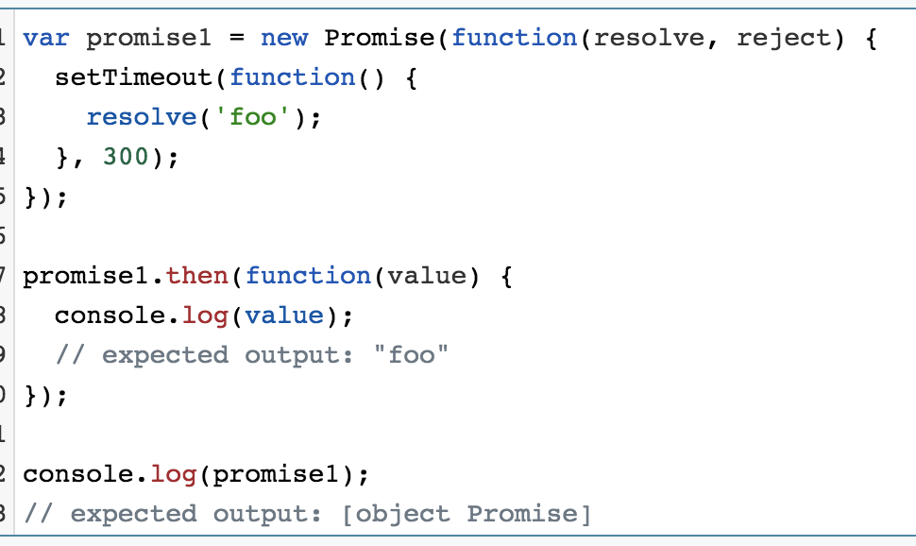
UI ENGINEERING STUDIO
UI Boot Camp: JS Functions
Promises
This is why JavaScript Promise libraries like Bluebird and Q got so much traction.
This method did not remove the use of callbacks, but it made the chaining of functions straightforward and simplified the code, making it much easier to read.
MDN

Slide 7
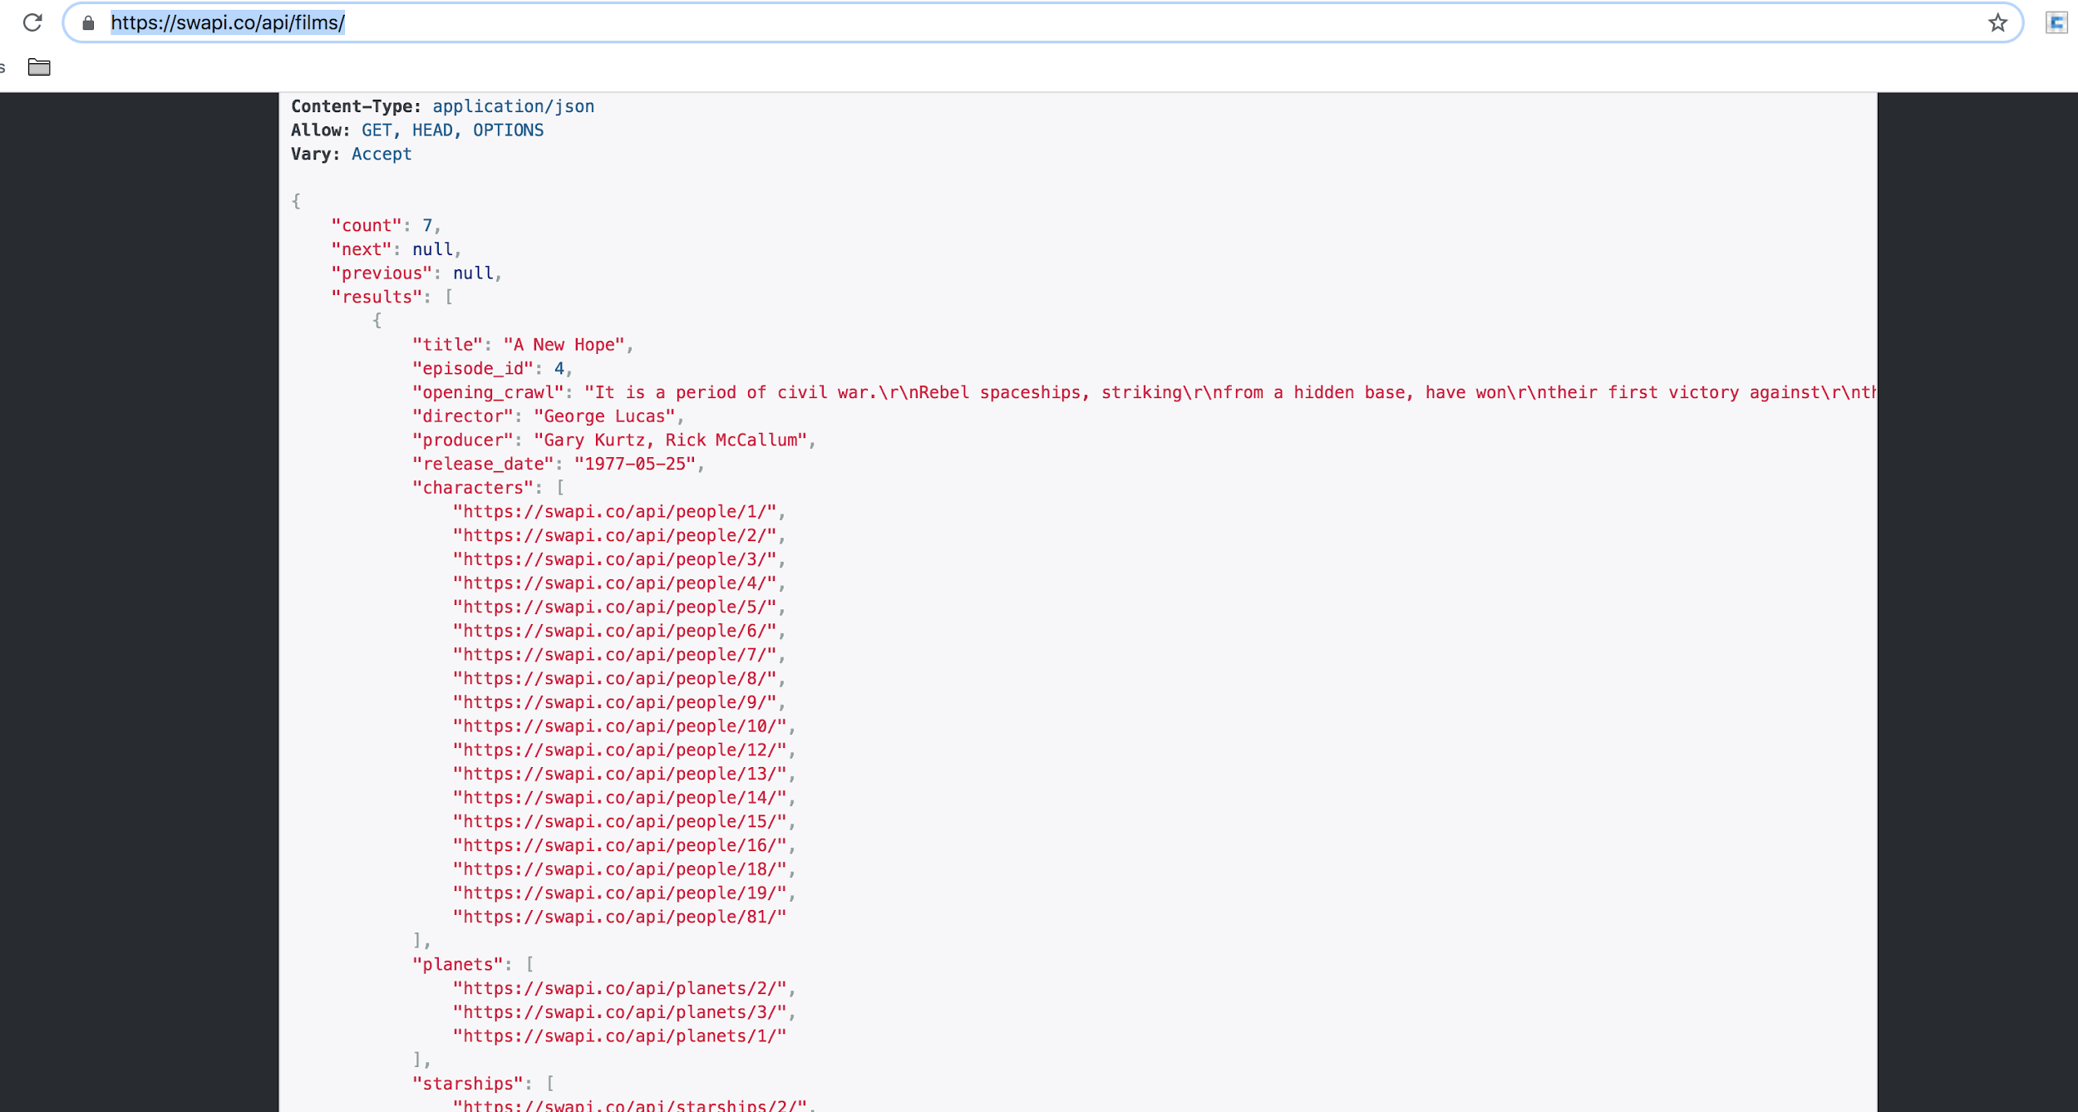
UI ENGINEERING STUDIO
UI Boot Camp: Basics JS Asyncronous
Homework: Async Await
https://swapi.co/api/
DIY: you have to study what are this features of javascript about, and bring some exercise done for next meeting
You might mdn as your reference, but the only one.
Scenario: given a list of films, create a <select> element that list them all.
When pickup one you should display details about the first of each attribute
Notes:
Null check, default default. foo && foo.baz
Counter example

Slide 8
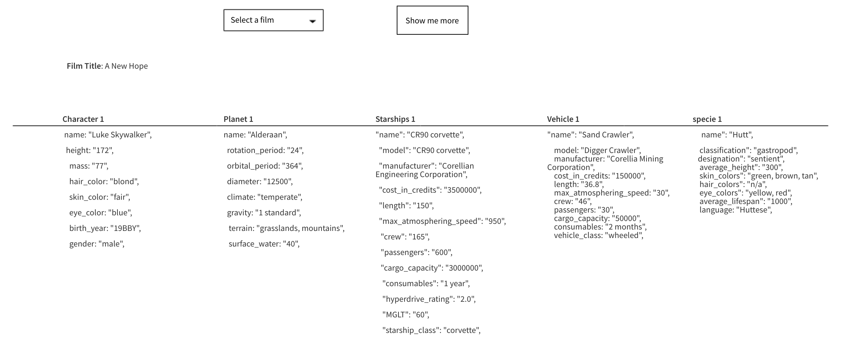
UI ENGINEERING STUDIO
UI Boot Camp: Basics JS Asyncronous
Homework: Stars wars APIs
https://swapi.co/api/
Styles colors and aspects should just be the one the browser use by default.
Notes:
Null check, default default. foo && foo.baz
Counter example

Slide 9
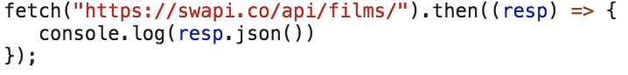
UI ENGINEERING STUDIO
UI Boot Camp: Basics JS Asyncronous
Homework: Stars wars APIs | Fetch API
https://swapi.co/api/
So, to accomplish this challenge you need a way of request to a backend services
Sample
We propouse you to use Fetch API, which provides an interface for fetching resources (including across the network). It will seem familiar to anyone who has used XMLHttpRequest, but the new API provides a more powerful and flexible feature set.
Fetch API
Using Fetch
Response object: here you can find what methods you have to get information from the response
Notes:
Null check, default default. foo && foo.baz
Counter example

Slide 10
Notes:
*

